Slide 1
Chapter 12: Mass-Storage Systems

Slide 2
Chapter 12: Mass-Storage Systems
Disk Structure
Disk Scheduling
Disk Management
Swap-Space Management

Slide 3
Objectives
Describe the physical structure of secondary and tertiary storage devices and the resulting effects on the uses of the devices
Explain the performance characteristics of mass-storage devices
Discuss operating-system services provided for mass storage, including RAID and HSM

Slide 4
Overview of Mass Storage Structure
Magnetic disks provide bulk of secondary storage of modern computers
Drives rotate at 60 to 250 times per second
Transfer rate is rate at which data flow between drive and computer
Positioning time (random-access time) is time to move disk arm to desired cylinder (seek time) and time for desired sector to rotate under the disk head (rotational latency)
Head crash results from disk head making contact with the disk surface
That’s bad
Disks can be removable
Drive attached to computer via I/O bus
Busses vary, including EIDE, ATA, SATA, USB, Fibre Channel, SCSI, SAS, Firewire
Host controller in computer uses bus to talk to disk controller built into drive or storage array

Slide 5
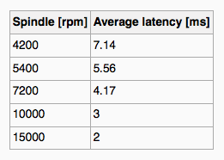
Magnetic Disks
Platters range from .85” to 14” (historically)
Commonly 3.5”, 2.5”, and 1.8”
Range from 30GB to 3TB per drive
Performance
Transfer Rate – theoretical – 6 Gb/sec
Effective Transfer Rate – real – 1Gb/sec
Seek time from 3ms to 12ms – 9ms common for desktop drives
Average seek time measured or calculated based on 1/3 of tracks
Latency based on spindle speed
1/(RPM * 60)
Average latency = ½ latency
(From Wikipedia)

Slide 6
Magnetic Disk Performance
Access Latency = Average access time = average seek time + average latency
For fastest disk 3ms + 2ms = 5ms
For slow disk 9ms + 5.56ms = 14.56ms
Average I/O time = average access time + (amount to transfer / transfer rate) + controller overhead
For example to transfer a 4KB block on a 7200 RPM disk with a 5ms average seek time, 1Gb/sec transfer rate with a .1ms controller overhead =
5ms + 4.17ms + 4KB / 1Gb/sec + 0.1ms =
9.27ms + 4 / 131072 sec =
9.27ms + .12ms = 9.39ms

Slide 7
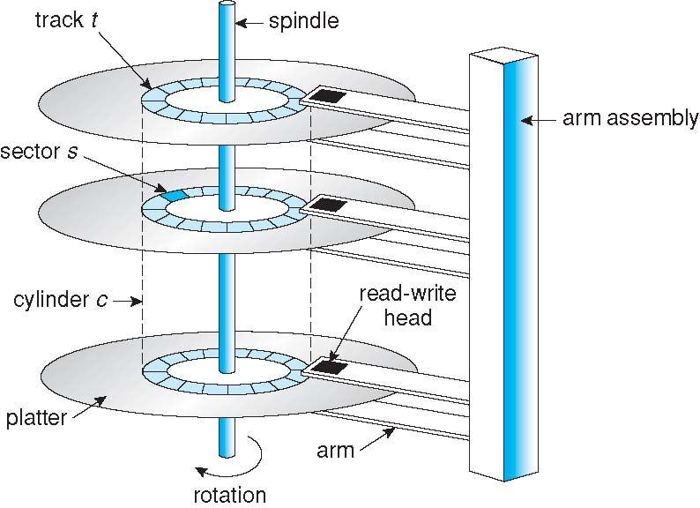
Moving-head Disk Mechanism

Slide 8
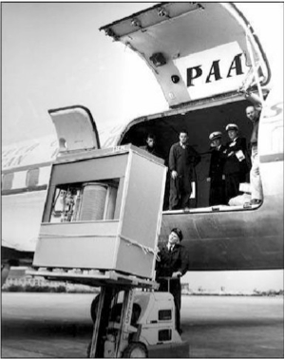
The First Commercial Disk Drive
1956
IBM RAMDAC computer included the IBM Model 350 disk storage system
5M (7 bit) characters
50 x 24” platters
Access time = < 1 second

Slide 9
Magnetic Tape
Was early secondary-storage medium
Evolved from open spools to cartridges
Relatively permanent and holds large quantities of data
Access time slow
Random access ~1000 times slower than disk
Mainly used for backup, storage of infrequently-used data, transfer medium between systems
Kept in spool and wound or rewound past read-write head
Once data under head, transfer rates comparable to disk
140MB/sec and greater
200GB to 1.5TB typical storage
Common technologies are LTO-{3,4,5} and T10000

Slide 10
Disk Structure
Disk drives are addressed as large 1-dimensional arrays of logical blocks, where the logical block is the smallest unit of transfer
The 1-dimensional array of logical blocks is mapped into the sectors of the disk sequentially
Sector 0 is the first sector of the first track on the outermost cylinder
Mapping proceeds in order through that track, then the rest of the tracks in that cylinder, and then through the rest of the cylinders from outermost to innermost
Logical to physical address should be easy
Except for bad sectors
Non-constant # of sectors per track via constant angular velocity (disk rotation constant but density of bits decreases from inner tracks to outer tracks to keep the data rate constant) CAV or CLV.

Slide 11
Disk Attachment
Host-attached storage accessed through I/O ports talking to I/O busses
SCSI itself is a bus, up to 16 devices on one cable, SCSI initiator requests operation and SCSI targets perform tasks
Each target can have up to 8 logical units (disks attached to device controller)
FC is high-speed serial architecture
Can be switched fabric with 24-bit address space – the basis of storage area networks (SANs) in which many hosts attach to many storage units
I/O directed to bus ID, device ID, logical unit (LUN)
IDE/ATA used by desktop PC max 2 drives per I/O bus. Similar protocol with simplified cabling is SATA. High servers or workstations use SCSI and FC.

Slide 12
Storage Array
Can just attach disks, or arrays of disks
Storage Array has controller(s), provides features to attached host(s)
Ports to connect hosts to array
Memory, controlling software (sometimes NVRAM, etc)
A few to thousands of disks
RAID, hot spares, hot swap (discussed later)
Shared storage -> more efficiency
Features found in some file systems
Snaphots, clones, thin provisioning, replication, deduplication, etc

Slide 13
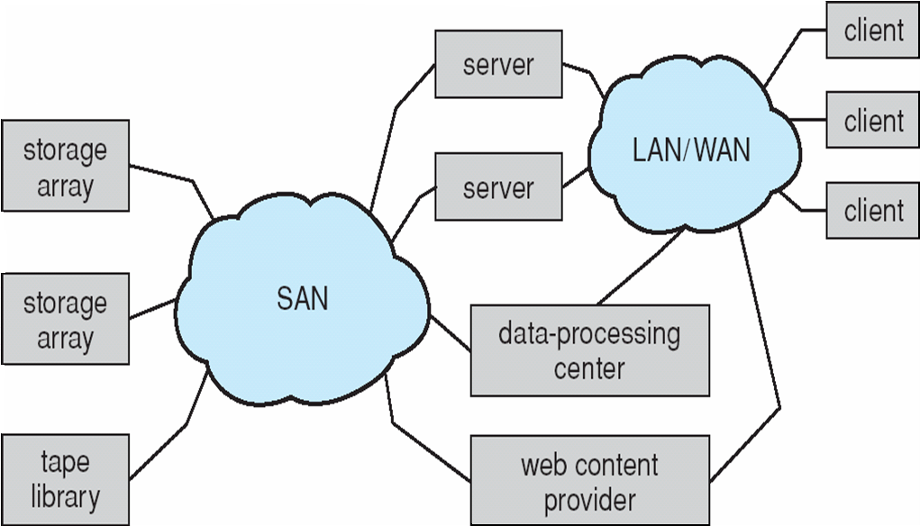
Storage Area Network
Common in large storage environments
Multiple hosts attached to multiple storage arrays - flexible

Slide 14
Storage Area Network (Cont.)
SAN is one or more storage arrays
Connected to one or more Fibre Channel switches
Hosts also attach to the switches
Storage made available via LUN Masking from specific arrays to specific servers
Easy to add or remove storage, add new host and allocate it storage
Over low-latency Fibre Channel fabric
Why have separate storage networks and communications networks?
Consider iSCSI, FCOE

Slide 15
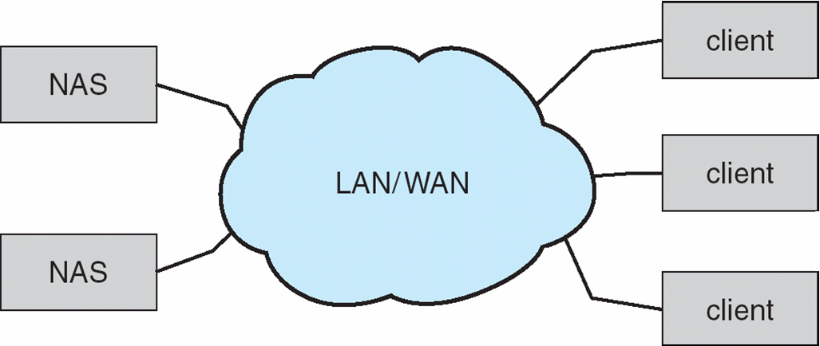
Network-Attached Storage
Network-attached storage (NAS) is storage made available over a network rather than over a local connection (such as a bus)
Remotely attaching to file systems
NFS and CIFS are common protocols
Implemented via remote procedure calls (RPCs) between host and storage over typically TCP or UDP on IP network
iSCSI protocol uses IP network to carry the SCSI protocol
Remotely attaching to devices (blocks)

Slide 16
Disk Scheduling
The operating system is responsible for using hardware efficiently — for the disk drives, this means having a fast access time and disk bandwidth
Minimize seek time
Seek time ≈ seek distance
Rotational latency
Disk bandwidth is the total number of bytes transferred, divided by the total time between the first request for service and the completion of the last transfer

Slide 17
Disk Scheduling (Cont.)
There are many sources of disk I/O request
OS
System processes
Users processes
I/O request includes input or output mode, disk address, memory address, number of sectors to transfer
OS maintains queue of requests, per disk or device
Idle disk can immediately work on I/O request, busy disk means work must queue
Optimization algorithms only make sense when a queue exists
Note that drive controllers have small buffers and can manage a queue of I/O requests (of varying “depth”)
Several algorithms exist to schedule the servicing of disk I/O requests
The analysis is true for one or many platters
We illustrate scheduling algorithms with a request queue (0-199)
98, 183, 37, 122, 14, 124, 65, 67
Head pointer 53

Slide 18
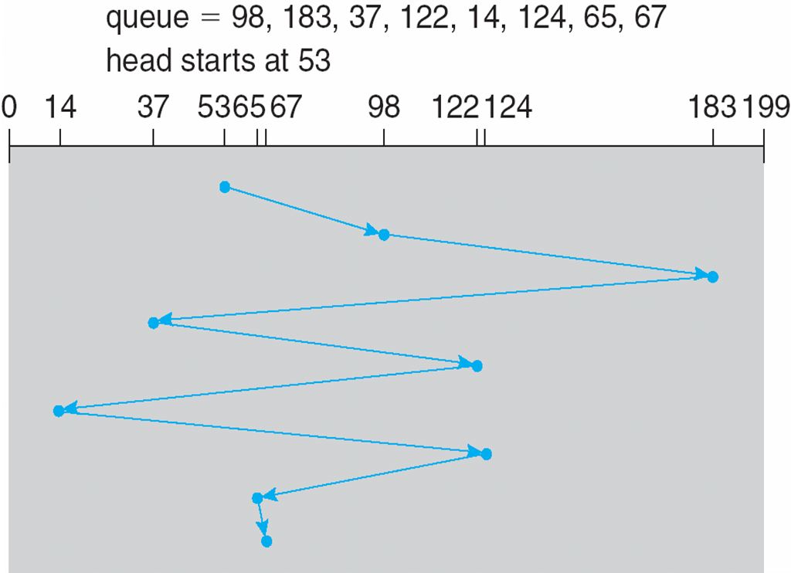
FCFS
Illustration shows total head movement of 640 cylinders

Slide 19
SSTF
Shortest Seek Time First selects the request with the minimum seek time from the current head position
SSTF scheduling is a form of SJF scheduling; may cause starvation of some requests
Illustration shows total head movement of 236 cylinders

Slide 20
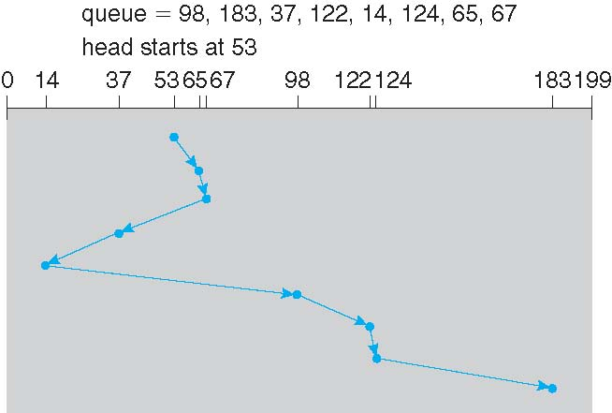
SSTF (Cont.)

Slide 21
SCAN
The disk arm starts at one end of the disk, and moves toward the other end, servicing requests until it gets to the other end of the disk, where the head movement is reversed and servicing continues.
SCAN algorithm Sometimes called the elevator algorithm
Illustration shows total head movement of 208 cylinders
But note that if requests are uniformly dense, largest density at other end of disk and those wait the longest

Slide 22
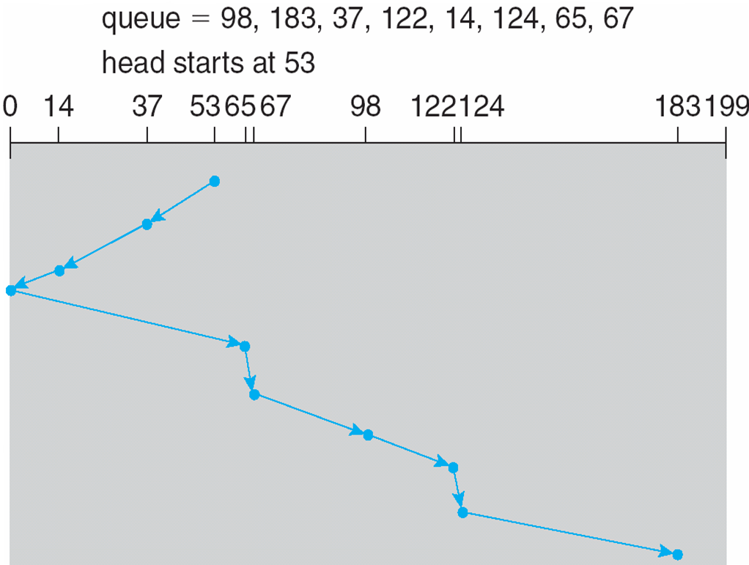
SCAN (Cont.)

Slide 23
C-SCAN
Provides a more uniform wait time than SCAN
The head moves from one end of the disk to the other, servicing requests as it goes
When it reaches the other end, however, it immediately returns to the beginning of the disk, without servicing any requests on the return trip
Treats the cylinders as a circular list that wraps around from the last cylinder to the first one
Total number of cylinders?

Slide 24
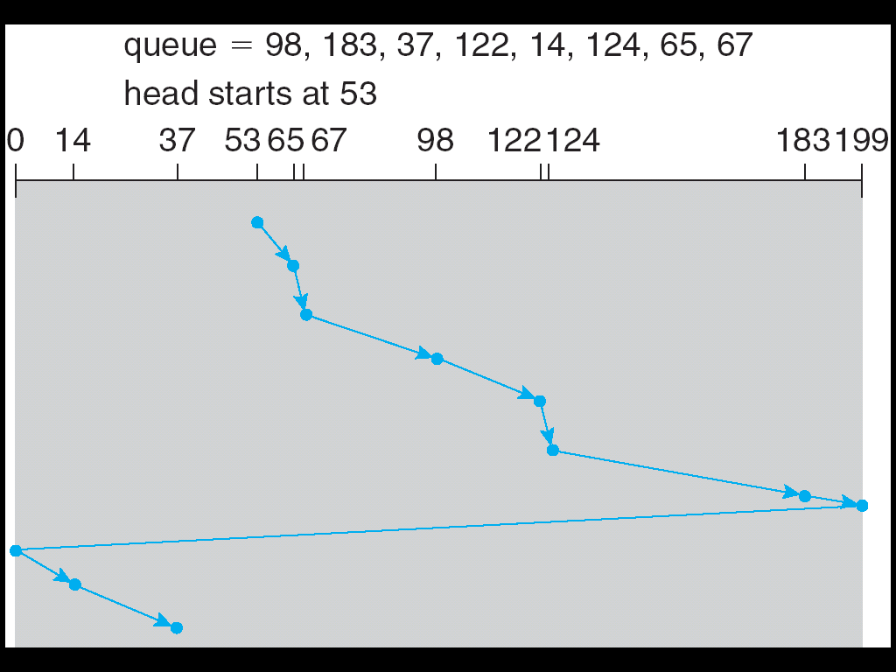
C-SCAN (Cont.)

Slide 25
LOOK and C-LOOK
LOOK a version of SCAN, C-LOOK a version of C-SCAN
Arm only goes as far as the last request in each direction, then reverses direction immediately, without first going all the way to the end of the disk
Total number of cylinders?

Slide 26
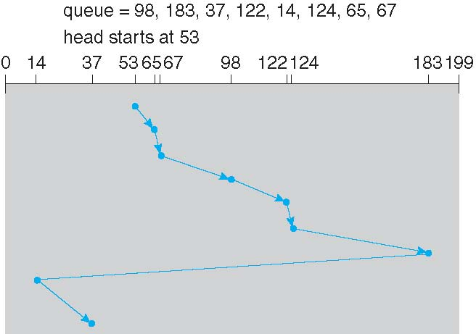
C-LOOK (Cont.)

Slide 27
Selecting a Disk-Scheduling Algorithm
SSTF is common and has a natural appeal
SCAN and C-SCAN perform better for systems that place a heavy load on the disk
Less starvation
Performance depends on the number and types of requests
Requests for disk service can be influenced by the file-allocation method
And metadata layout
The disk-scheduling algorithm should be written as a separate module of the operating system, allowing it to be replaced with a different algorithm if necessary
Either SSTF or LOOK is a reasonable choice for the default algorithm
What about rotational latency?
Difficult for OS to calculate

Slide 28
Disk Management
Low-level formatting, or physical formatting — Dividing a disk into sectors that the disk controller can read and write
Each sector can hold header information, plus data, plus error correction code (ECC)
Usually 512 bytes of data but can be selectable
To use a disk to hold files, the operating system still needs to record its own data structures on the disk
Partition the disk into one or more groups of cylinders, each treated as a logical disk
Logical formatting or “making a file system”
To increase efficiency most file systems group blocks into clusters
Disk I/O done in blocks
File I/O done in clusters
Boot block initializes system
The bootstrap is stored in ROM
Bootstrap loader program stored in boot blocks of boot partition
Methods such as sector sparing used to handle bad blocks- MS DOS Format or chkdsk, SCSI disks – controller maintains a list of bad blocks. List initialized during low level formatting and updated over life of disk.
Sector sparing and another method sector slipping. Hard error and soft error.

Slide 29
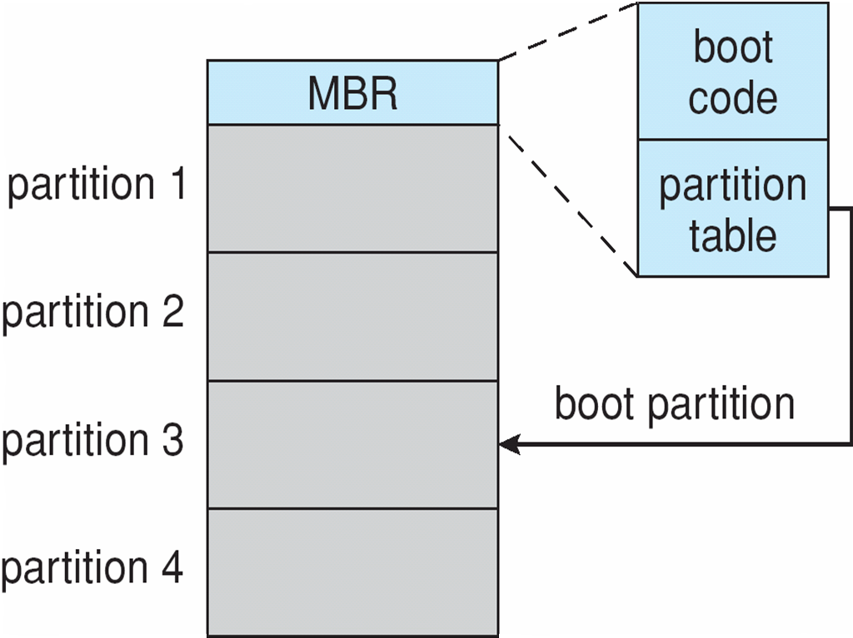
Booting from a Disk in Windows 2000

Slide 30
Swap-Space Management
Swap-space — Virtual memory uses disk space as an extension of main memory
Less common now due to memory capacity increases
Swap-space can be carved out of the normal file system, or, more commonly, it can be in a separate disk partition (raw)
Swap-space management
4.3BSD allocates swap space when process starts; holds text segment (the program) and data segment
Kernel uses swap maps to track swap-space use
Solaris 2 allocates swap space only when a dirty page is forced out of physical memory, not when the virtual memory page is first created
File data written to swap space until write to file system requested
Other dirty pages go to swap space due to no other home
Text segment pages thrown out and reread from the file system as needed
What if a system runs out of swap space?
Some systems allow multiple swap spaces

Slide 31
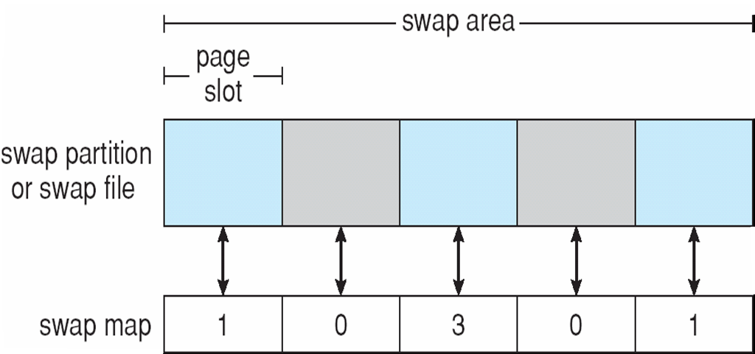
Data Structures for Swapping on Linux Systems

Slide 32
RAID Structure
RAID – multiple disk drives provides reliability via redundancy
Increases the mean time to failure
Frequently combined with NVRAM to improve write performance
RAID is arranged into six different levels

Slide 33
RAID (Cont.)
Several improvements in disk-use techniques involve the use of multiple disks working cooperatively
Disk striping uses a group of disks as one storage unit
RAID schemes improve performance and improve the reliability of the storage system by storing redundant data
Mirroring or shadowing (RAID 1) keeps duplicate of each disk
Striped mirrors (RAID 1+0) or mirrored stripes (RAID 0+1) provides high performance and high reliability
Block interleaved parity (RAID 4, 5, 6) uses much less redundancy
RAID within a storage array can still fail if the array fails, so automatic replication of the data between arrays is common
Frequently, a small number of hot-spare disks are left unallocated, automatically replacing a failed disk and having data rebuilt onto them

Slide 34
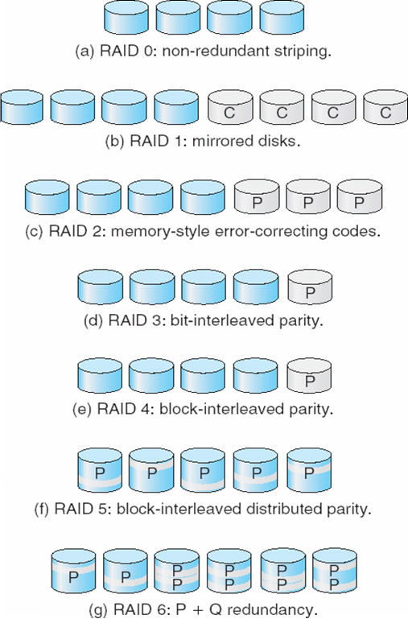
RAID Levels

Slide 35
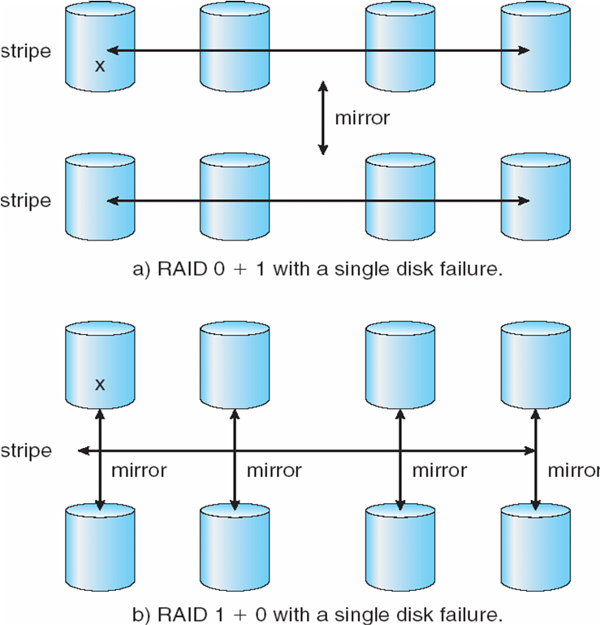
RAID (0 + 1) and (1 + 0)

Slide 36
Extensions
RAID alone does not prevent or detect data corruption or other errors, just disk failures
Solaris ZFS adds checksums of all data and metadata
Checksums kept with pointer to object, to detect if object is the right one and whether it changed
Can detect and correct data and metadata corruption
ZFS also removes volumes, partititions
Disks allocated in pools
Filesystems with a pool share that pool, use and release space like “malloc” and “free” memory allocate / release calls

Slide 37
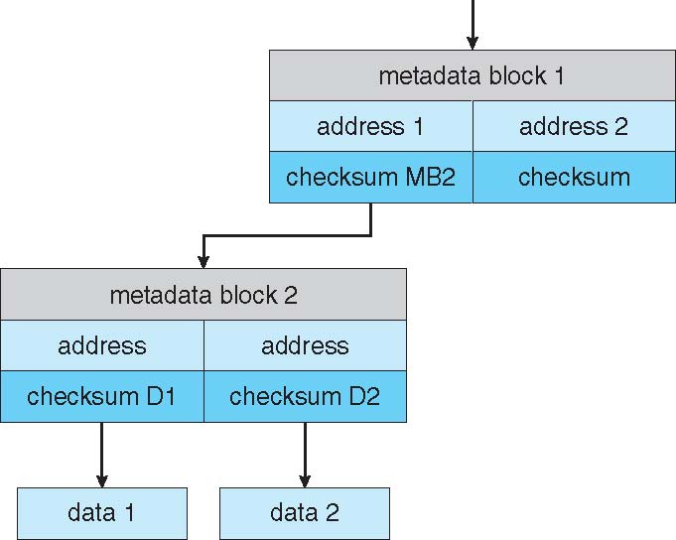
ZFS Checksums All Metadata and Data

Slide 38
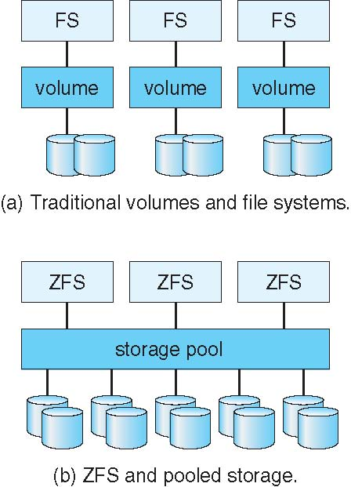
Traditional and Pooled Storage

Slide 39
Stable-Storage Implementation
Write-ahead log scheme requires stable storage
To implement stable storage:
Replicate information on more than one nonvolatile storage media with independent failure modes
Update information in a controlled manner to ensure that we can recover the stable data after any failure during data transfer or recovery

Slide 40
Tertiary Storage Devices
Low cost is the defining characteristic of tertiary storage
Generally, tertiary storage is built using removable media
Common examples of removable media are floppy disks and CD-ROMs; other types are available

Slide 41
Removable Disks
Floppy disk — thin flexible disk coated with magnetic material, enclosed in a protective plastic case
Most floppies hold about 1 MB; similar technology is used for removable disks that hold more than 1 GB
Removable magnetic disks can be nearly as fast as hard disks, but they are at a greater risk of damage from exposure

Slide 42
Removable Disks (Cont.)
A magneto-optic disk records data on a rigid platter coated with magnetic material
Laser heat is used to amplify a large, weak magnetic field to record a bit
Laser light is also used to read data (Kerr effect)
The magneto-optic head flies much farther from the disk surface than a magnetic disk head, and the magnetic material is covered with a protective layer of plastic or glass; resistant to head crashes
Optical disks do not use magnetism; they employ special materials that are altered by laser light

Slide 43
WORM Disks
The data on read-write disks can be modified over and over
WORM (“Write Once, Read Many Times”) disks can be written only once
Thin aluminum film sandwiched between two glass or plastic platters
To write a bit, the drive uses a laser light to burn a small hole through the aluminum; information can be destroyed by not altered
Very durable and reliable
Read-only disks, such ad CD-ROM and DVD, com from the factory with the data pre-recorded

Slide 44
Tapes
Compared to a disk, a tape is less expensive and holds more data, but random access is much slower.
Tape is an economical medium for purposes that do not require fast random access, e.g., backup copies of disk data, holding huge volumes of data.
Large tape installations typically use robotic tape changers that move tapes between tape drives and storage slots in a tape library
stacker – library that holds a few tapes
silo – library that holds thousands of tapes
A disk-resident file can be archived to tape for low cost storage; the computer can stage it back into disk storage for active use.

Slide 45
Operating System Support
Major OS jobs are to manage physical devices and to present a virtual machine abstraction to applications
For hard disks, the OS provides two abstraction:
Raw device – an array of data blocks
File system – the OS queues and schedules the interleaved requests from several applications

Slide 46
Application Interface
Most OSs handle removable disks almost exactly like fixed disks — a new cartridge is formatted and an empty file system is generated on the disk
Tapes are presented as a raw storage medium, i.e., and application does not not open a file on the tape, it opens the whole tape drive as a raw device
Usually the tape drive is reserved for the exclusive use of that application
Since the OS does not provide file system services, the application must decide how to use the array of blocks
Since every application makes up its own rules for how to organize a tape, a tape full of data can generally only be used by the program that created it

Slide 47
Tape Drives
The basic operations for a tape drive differ from those of a disk drive
locate()positions the tape to a specific logical block, not an entire track (corresponds to seek())
The read position()operation returns the logical block number where the tape head is
The space()operation enables relative motion
Tape drives are “append-only” devices; updating a block in the middle of the tape also effectively erases everything beyond that block
An EOT mark is placed after a block that is written

Slide 48
File Naming
The issue of naming files on removable media is especially difficult when we want to write data on a removable cartridge on one computer, and then use the cartridge in another computer.
Contemporary OSs generally leave the name space problem unsolved for removable media, and depend on applications and users to figure out how to access and interpret the data.
Some kinds of removable media (e.g., CDs) are so well standardized that all computers use them the same way.

Slide 49
Hierarchical Storage Management (HSM)
A hierarchical storage system extends the storage hierarchy beyond primary memory and secondary storage to incorporate tertiary storage — usually implemented as a jukebox of tapes or removable disks.
Usually incorporate tertiary storage by extending the file system
Small and frequently used files remain on disk
Large, old, inactive files are archived to the jukebox
HSM is usually found in supercomputing centers and other large installations that have enormous volumes of data.

Slide 50
Speed
Two aspects of speed in tertiary storage are bandwidth and latency.
Bandwidth is measured in bytes per second.
Sustained bandwidth – average data rate during a large transfer; # of bytes/transfer time Data rate when the data stream is actually flowing
Effective bandwidth – average over the entire I/O time, including seek() or locate(), and cartridge switching Drive’s overall data rate

Slide 51
Speed (Cont.)
Access latency – amount of time needed to locate data
Access time for a disk – move the arm to the selected cylinder and wait for the rotational latency; < 35 milliseconds
Access on tape requires winding the tape reels until the selected block reaches the tape head; tens or hundreds of seconds
Generally say that random access within a tape cartridge is about a thousand times slower than random access on disk
The low cost of tertiary storage is a result of having many cheap cartridges share a few expensive drives
A removable library is best devoted to the storage of infrequently used data, because the library can only satisfy a relatively small number of I/O requests per hour

Slide 52
Reliability
A fixed disk drive is likely to be more reliable than a removable disk or tape drive
An optical cartridge is likely to be more reliable than a magnetic disk or tape
A head crash in a fixed hard disk generally destroys the data, whereas the failure of a tape drive or optical disk drive often leaves the data cartridge unharmed

Slide 53
Cost
Main memory is much more expensive than disk storage
The cost per megabyte of hard disk storage is competitive with magnetic tape if only one tape is used per drive
The cheapest tape drives and the cheapest disk drives have had about the same storage capacity over the years
Tertiary storage gives a cost savings only when the number of cartridges is considerably larger than the number of drives

Slide 54
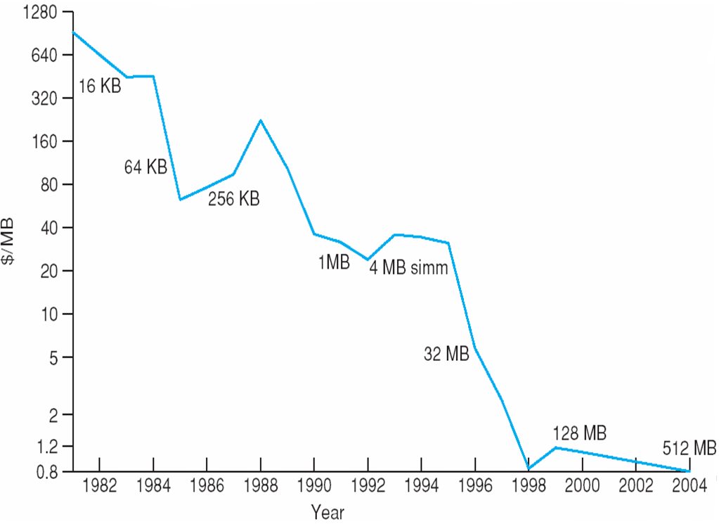
Price per Megabyte of DRAM From 1981 to 2004

Slide 55
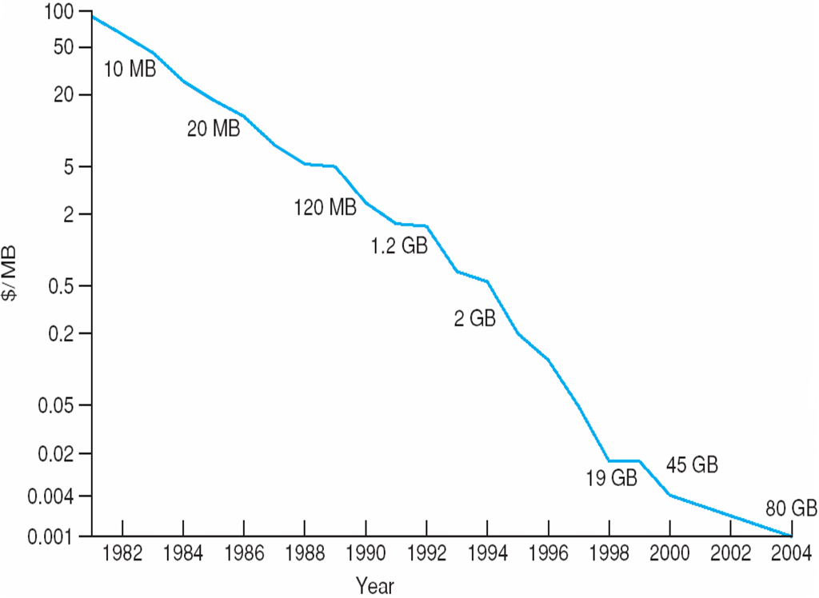
Price per Megabyte of Magnetic Hard Disk From 1981 to 2004

Slide 56
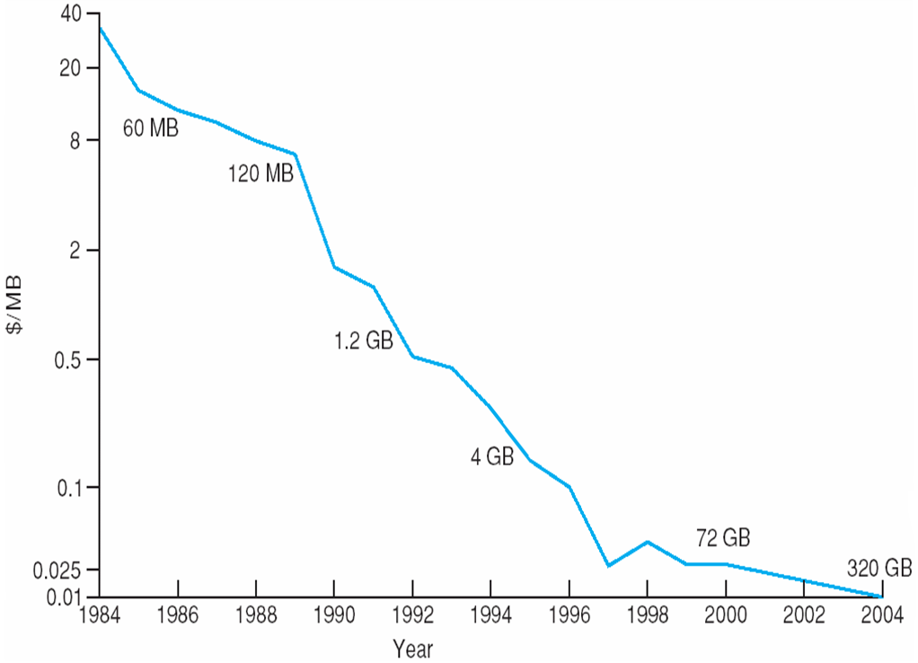
Price per Megabyte of a Tape Drive From 1984-2000

Slide 57
End of Chapter 12

